Slide 1
MALIGNANT COMMENTS CLASSIFICATION
SUBMITTED BY
KRISHNA PRASAD

Slide 2

comments

Slide 3

INTRODUCTION

Slide 4
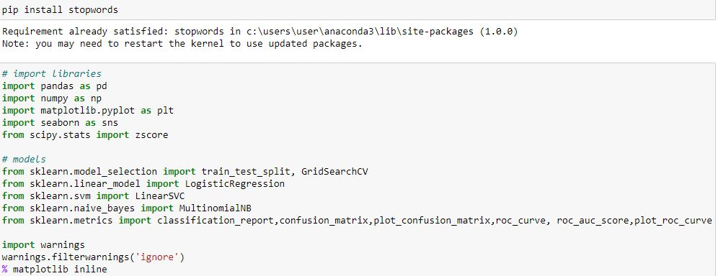
lIBRARIES

Slide 5
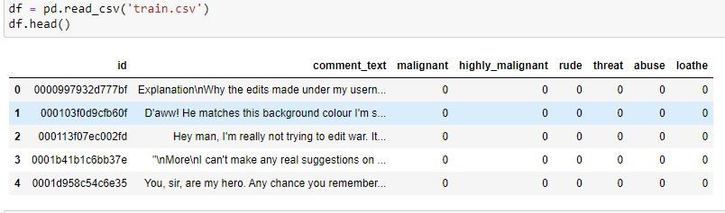
dataset

Slide 6
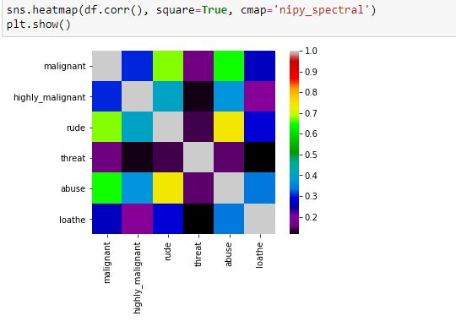
Correlation

Slide 7

CHECKING ROWS & COLUMNS

Slide 8
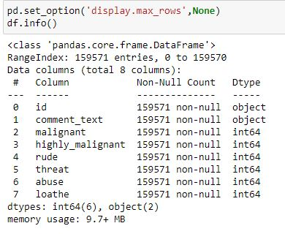
Checking columns type

Slide 9

CHECKING DUPLICATES

Slide 10
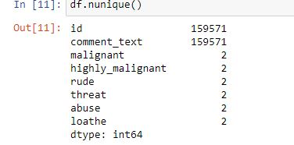
CHECKING CONTINOUS & CATEGORICAL COLUMNS

Slide 11
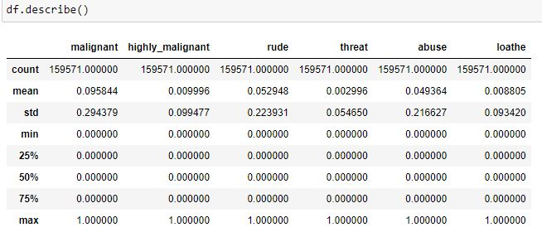
DESCRIBE THE DATASET

Slide 12

DROPING COLUMN

Slide 13
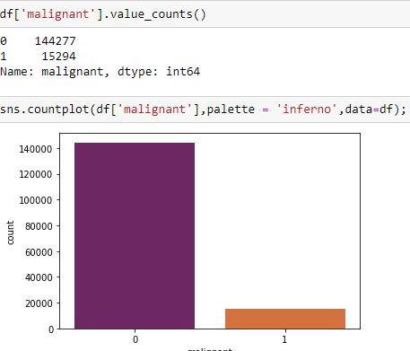
MALIGNANT COLUMN

Slide 14
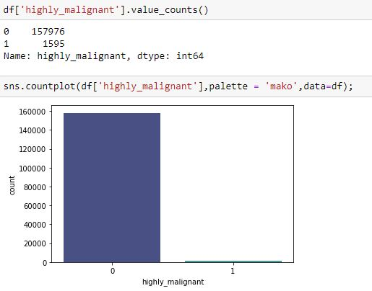
HIGHLY MALIGNANT

Slide 15
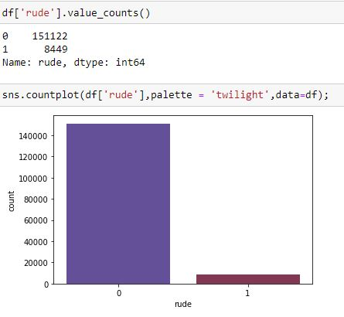
RUDE

Slide 16
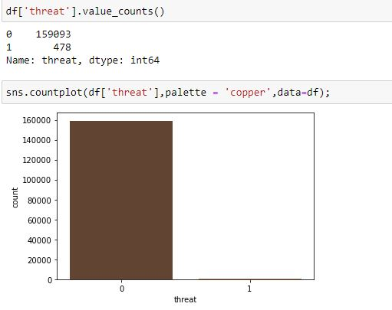
THREAT

Slide 17
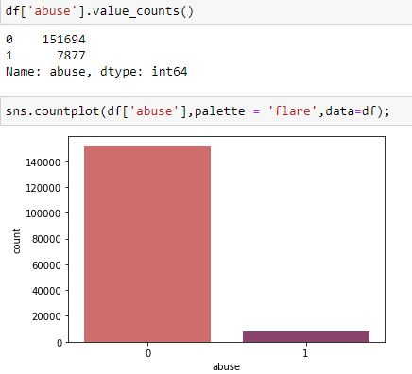
ABUSE

Slide 18
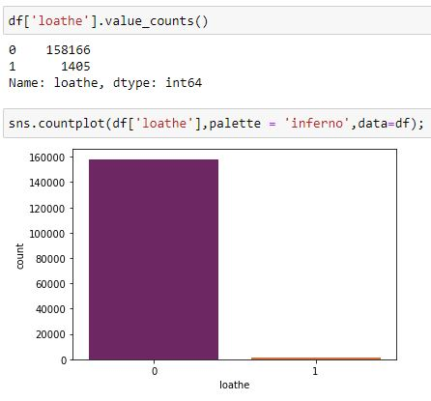
LOATHE

Slide 19
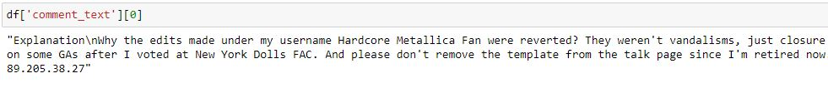
COMMENTS

Slide 20

nltk

Slide 21
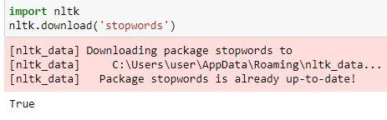
STOPWARDS

Slide 22
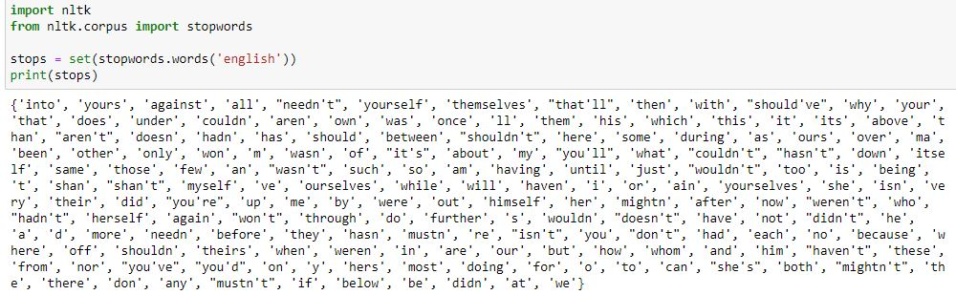
PRINTING ALL THE STOPWARDS

Slide 23

IMPORTING WORD NET LEMMATIZER

Slide 24
IMPORTING PORTER STEMER

Slide 25

Importing Regular expressions

Slide 26
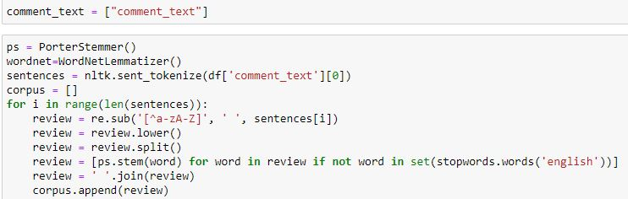
Using poster stemmer & word net lemmatizer

Slide 27

Count vectorizer

Slide 28
Listing all the labels

Slide 29
Train test split

Slide 30

Checking the shape

Slide 31
Machine Learning
Model Building

Slide 32
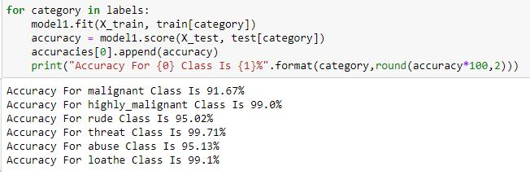
Multinomial Naive Bayes

Slide 33

Linear Support Vector Classifier

Slide 34
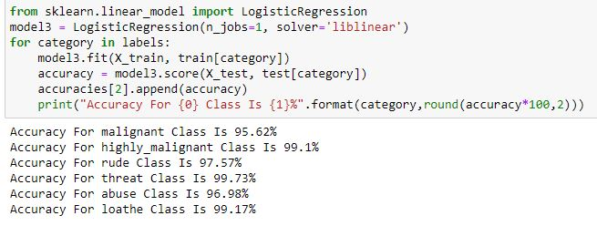
Logistic Regression

Slide 35
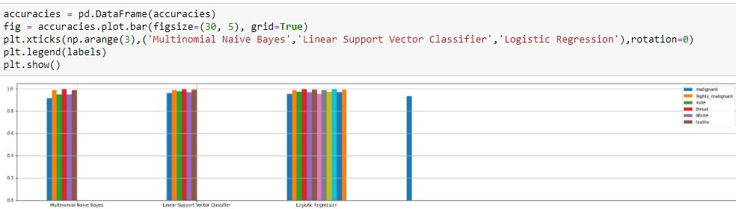
Bar Plot for 3 model predition

Slide 36
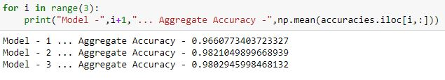
Aggregate accuracy

Slide 37
Interpretation of the Results
I have used visualization tool such as count Plot to understand the data in a better way.
I used describe method for five-point summary analysis and also found the number of rows and columns in dataset.
I have done the model building with 3 algorithms and the best model is Linear Support Vector Classifier with an accuracy score of 98.21%

Slide 38
CONCLUSIONS
I have managed out how to prepare a model that gives users for a novel best approach at future lodging value predictions.
I have train dataset from which I had to extract information.
I had used pandas library to read the Dataset which provide me to explore & visualize the Data properly based on Rows & Columns.
I did exploratory data analysis on main data frame and tried to see all visualizations.
Based on visualization knowledge, I use various EDA TECHNIQUES to plot the count plot.
After from all these I split the Features & Labels into 2 parts.
On this data, I have applied our machine learning classification models such as Logistic regression, Linear Support Vector Classifier and Multinomial Naive Bayes train dataset.
After which I found Linear Support Vector Classifier has the High accuracy score(98.21%) and best among all the regressor models.

